Slide 1
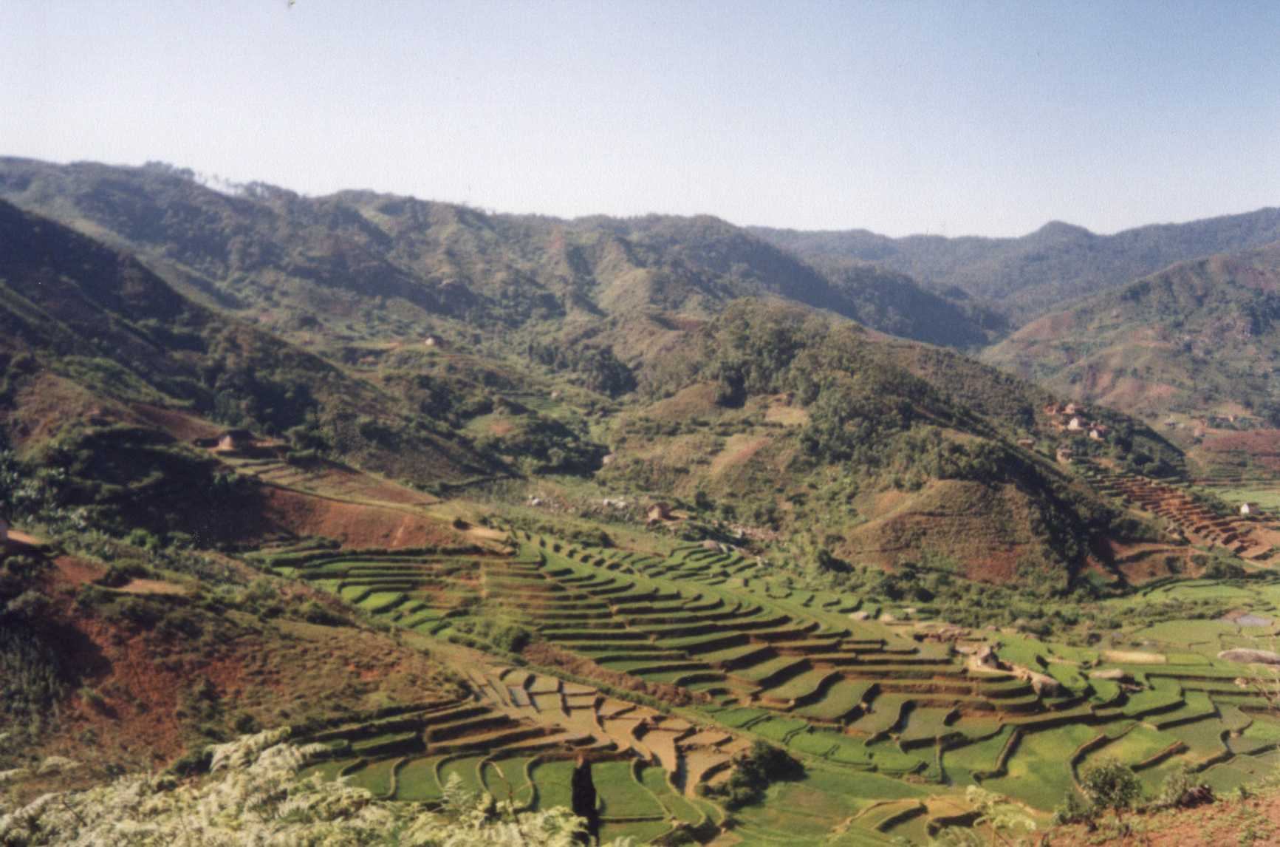

Slide 2
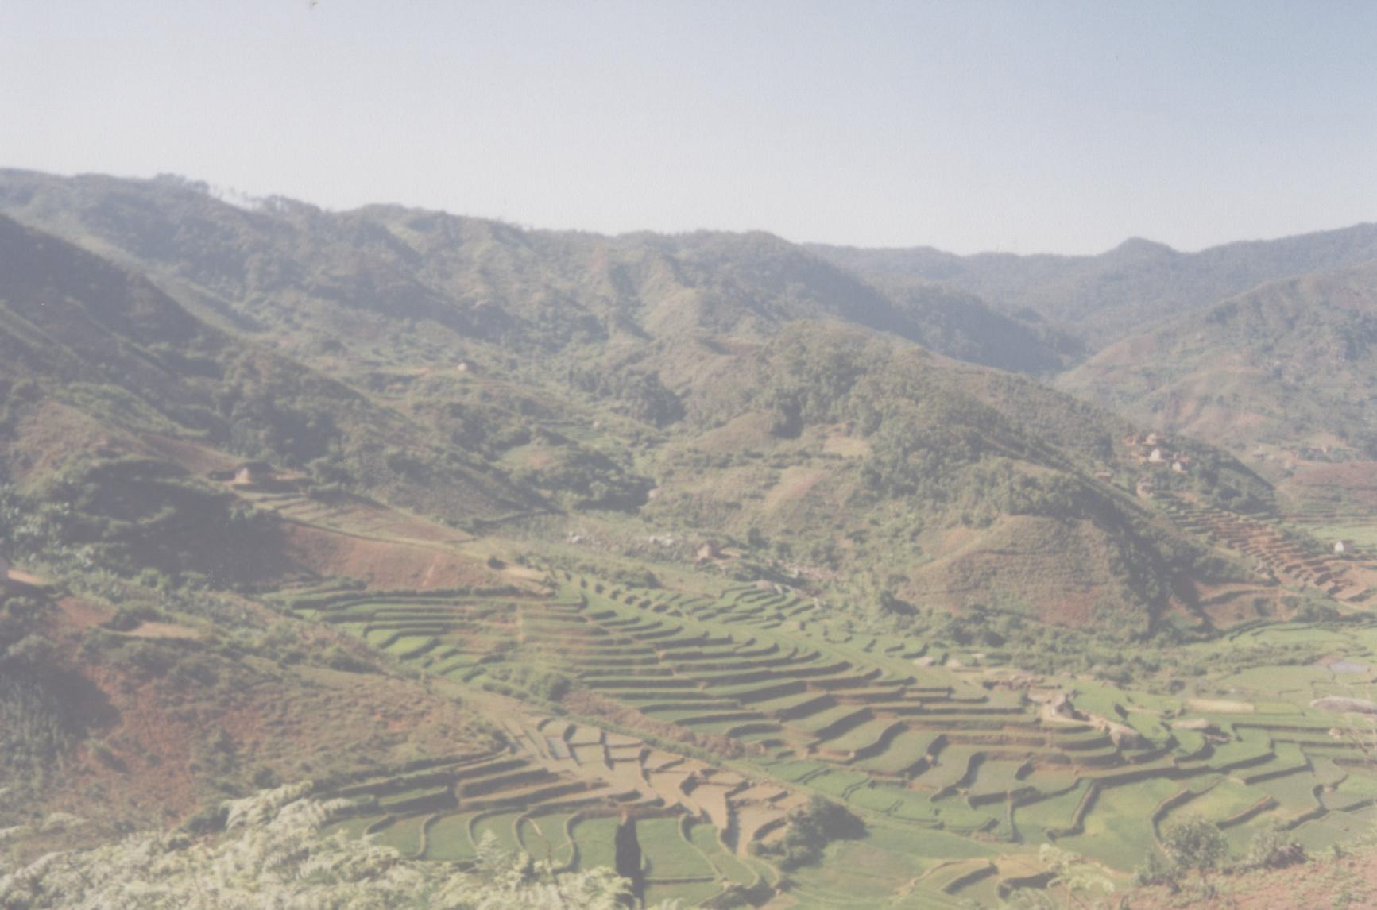

Community Based Natural Resource Management in Madagascar
Henri P. Josserand, Ph.D.
December 17, 2001
Financing: USAID/AFR-SD/ANRE

Slide 3
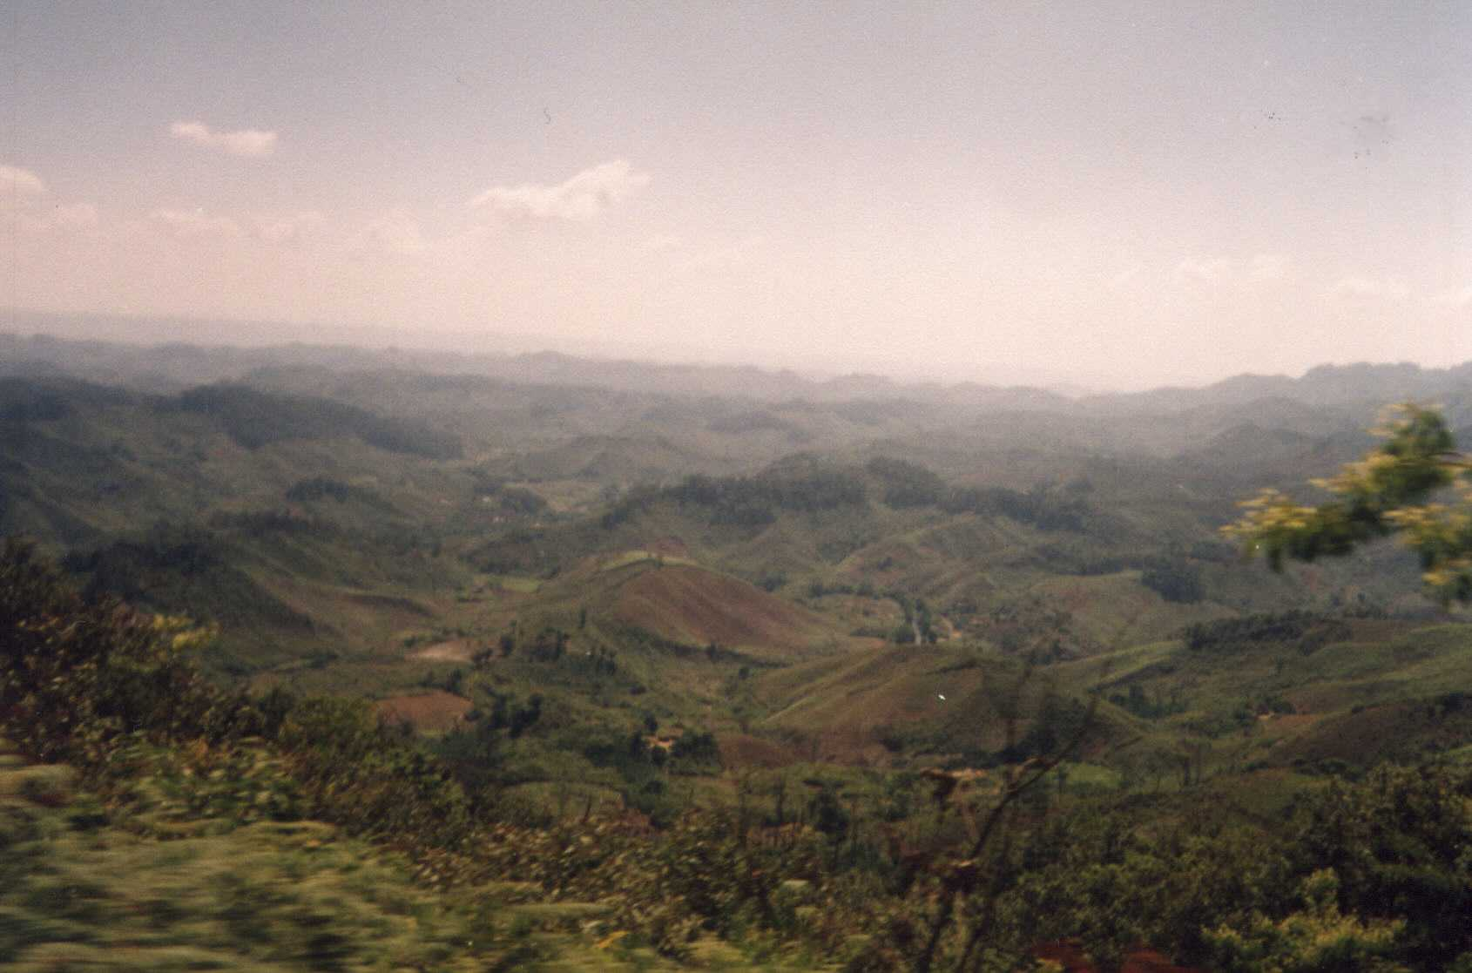
Scope of Work
Compare experiences AFR-Madagascar
including relevant factors of success
+/- of various approaches
Strategies for ‘scaling up’
Specific approaches to scaling up
Exchange of lessons learned

Slide 4
General -
Pressure for Resource Transfer Contracts...
    General awareness of trends, resource conditions
    Mounting political pressure to reform
    Communities’ awareness of dynamics (incl. demog)
    Communities make the link between CBNRM and rural development
    This is problematic, and dangerous

Slide 5
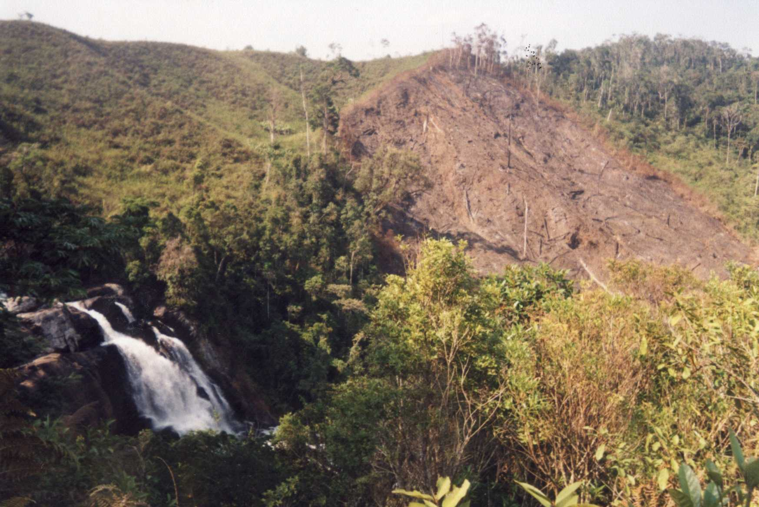
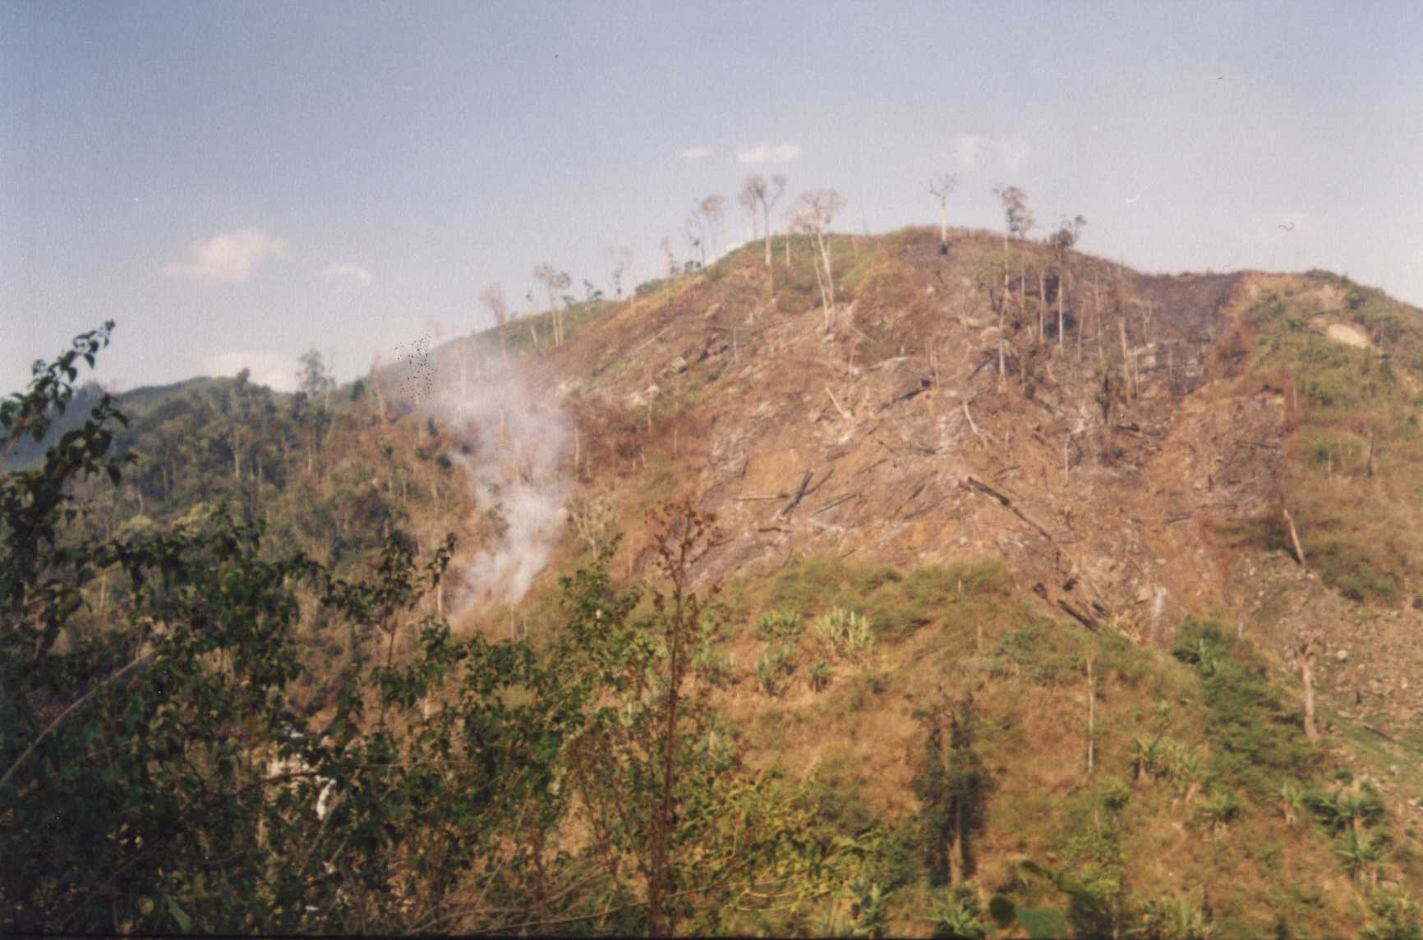
Results of ‘tavy’
Moramanga Province

Slide 6
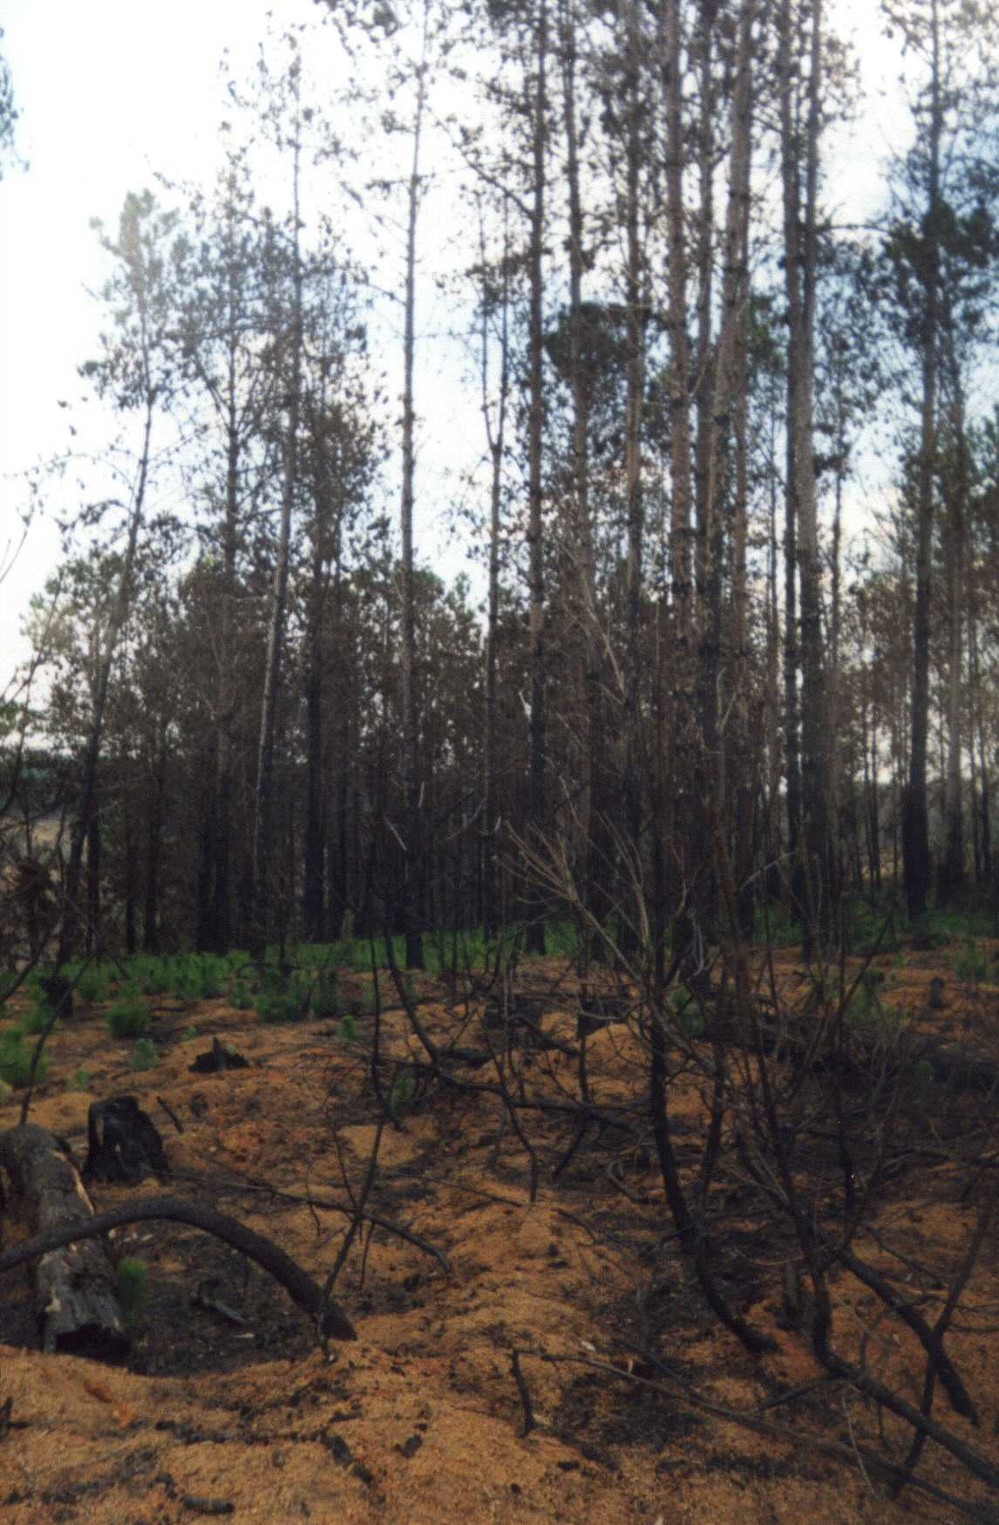
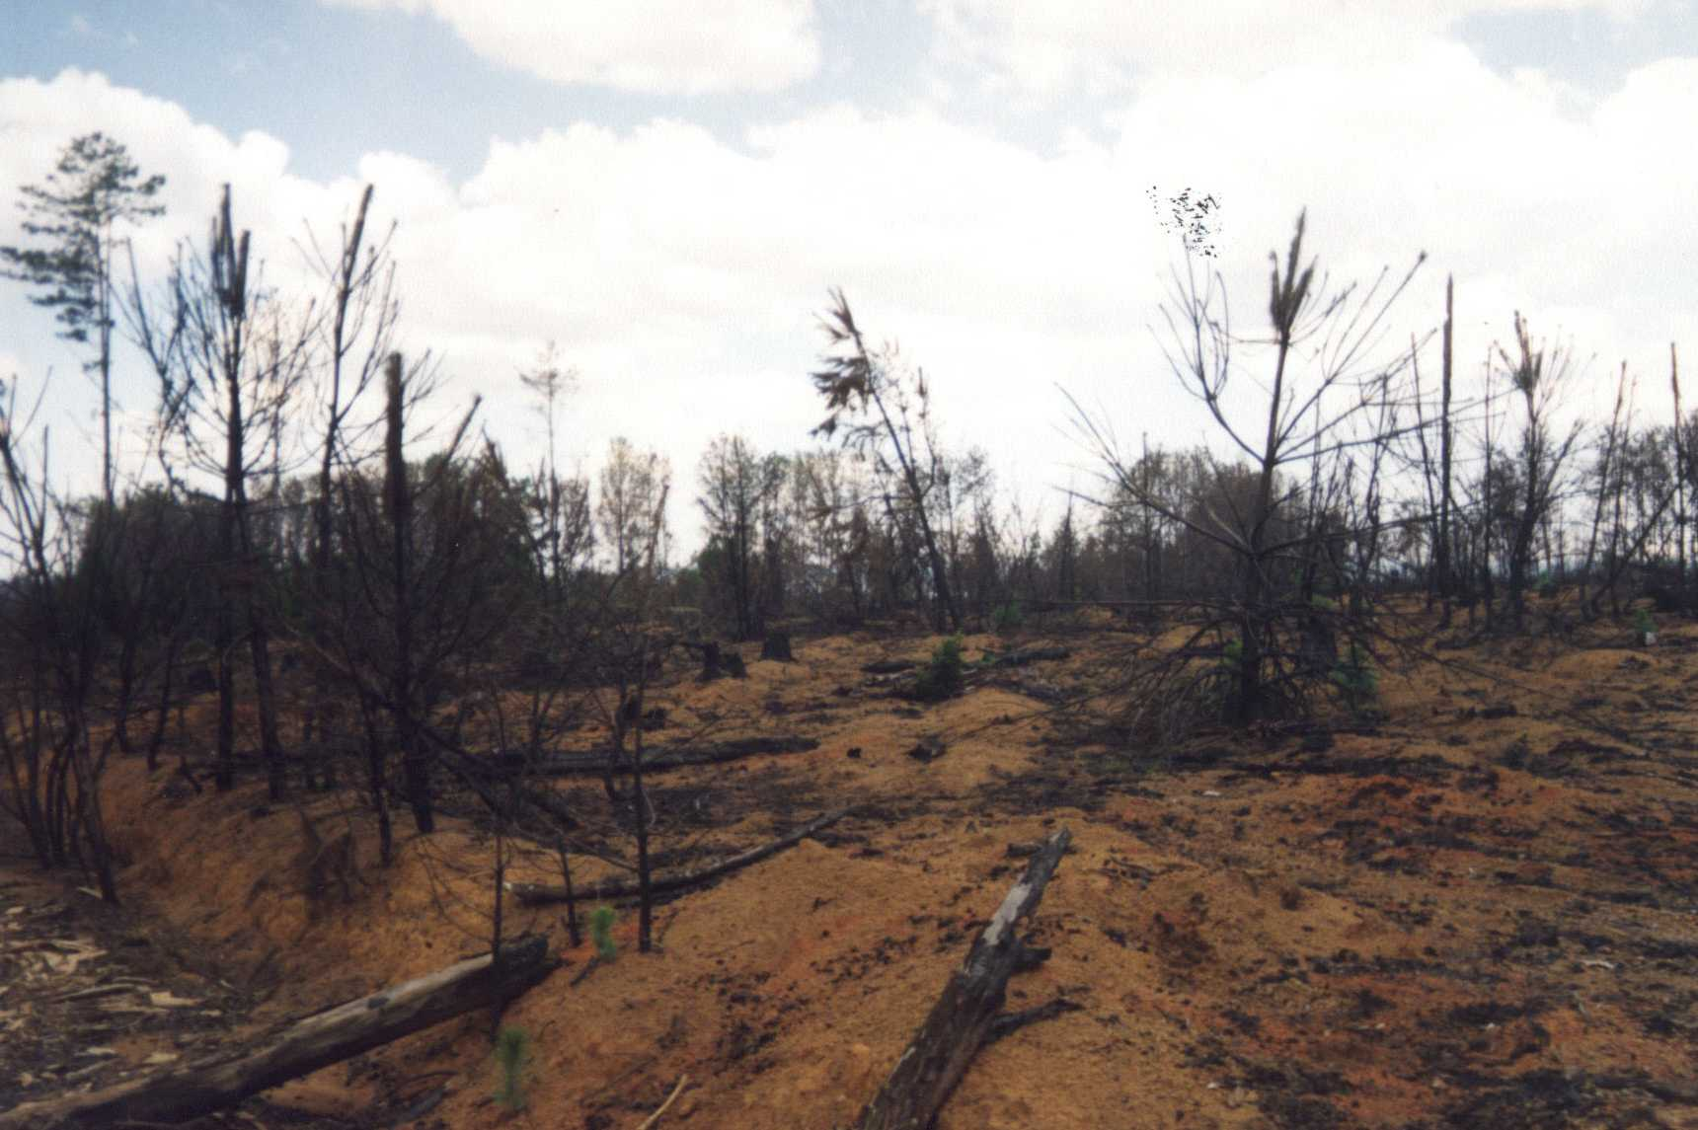
Burning in Fanalamanga pine forest

Slide 7
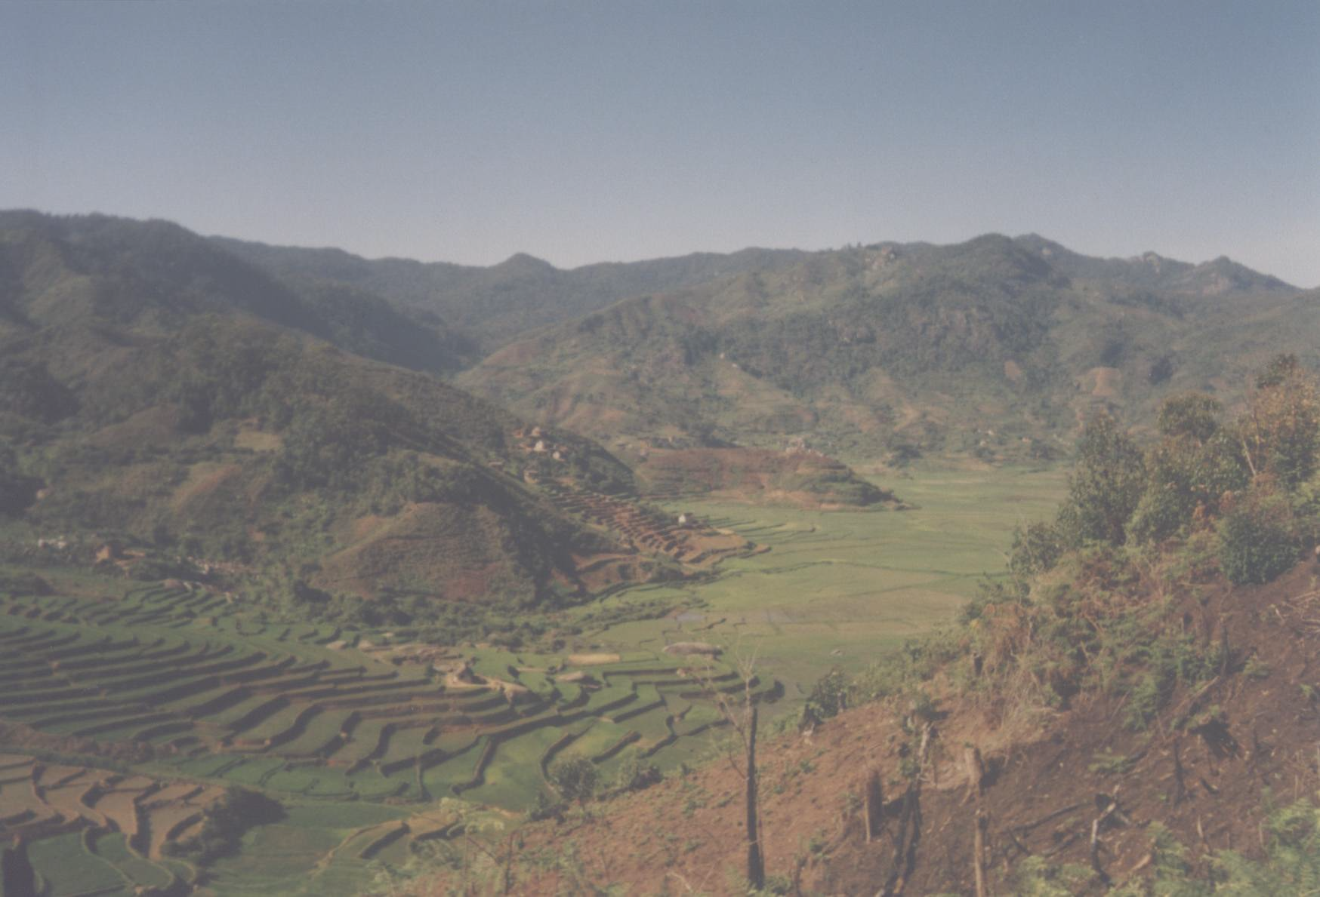
Problem:
Current rate of resource transfer is unsustainable:
Legal instruments: “work in progress” cumbersome
Main problem is lack of capacity to follow-through, at all levels
Cannot ‘cut corners’ especially since national institutions are not fully on-board - Obstruction

Slide 8
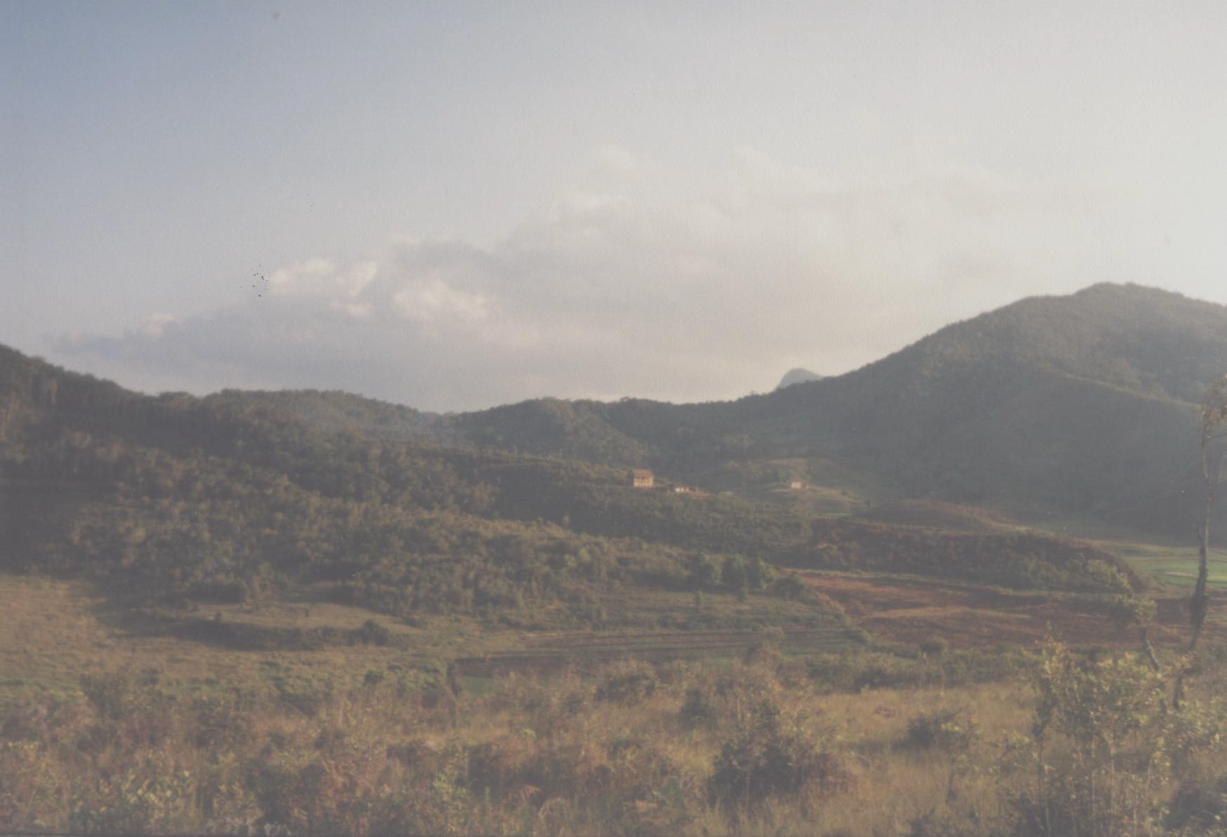
Problem (2):
Current rate of resource transfer is unsustainable:
More crucial at implementation stage; ‘hostage taking’
No preparation for community based commercial activities
Importance of financial viability of CBNRM
Need to include all potential benefits (Analasoa, Fanalamanga)

Slide 9
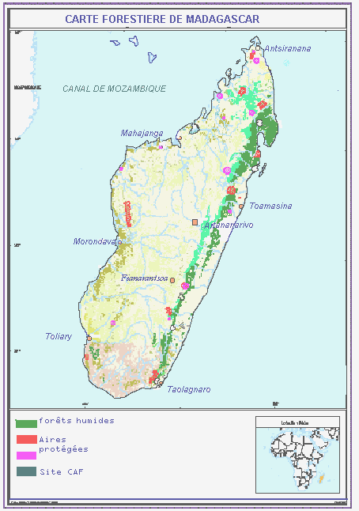
Specific: Results from Field Visits
    Province of Moramanga:
    Faravohitra, Analasoa, Didy
    Province of Fianarantsoa:
    Miarinarivo,
    Tsibahambo and Mandriandry (near Tolongoina).

Slide 10
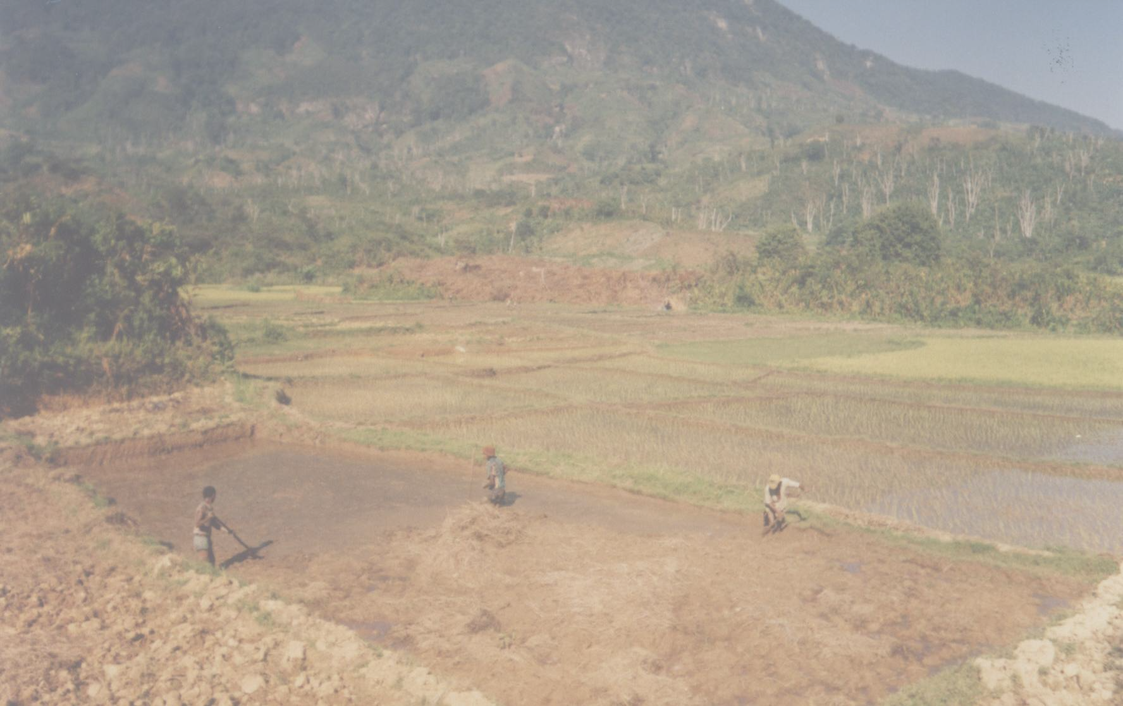
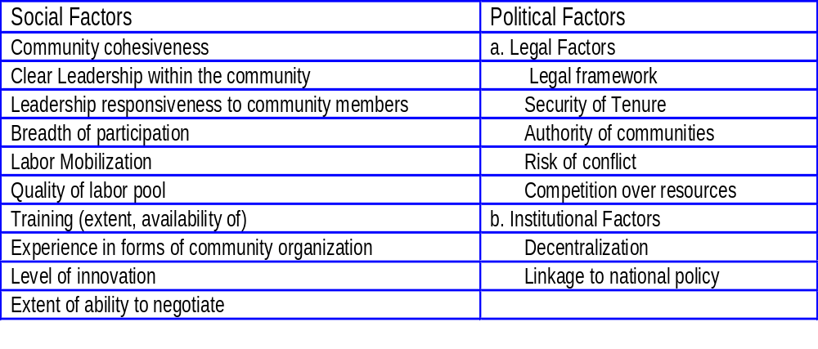
Social, Political Factors

Slide 11
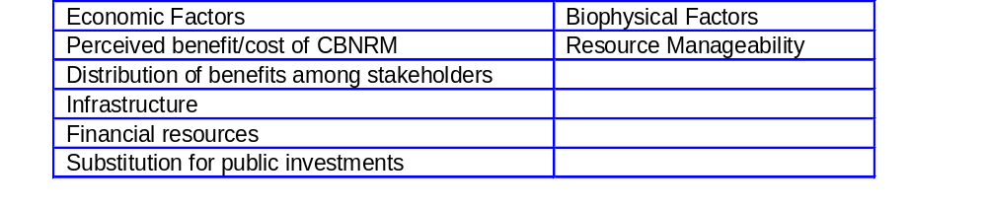
Economic, Biophysical Factors

Slide 12
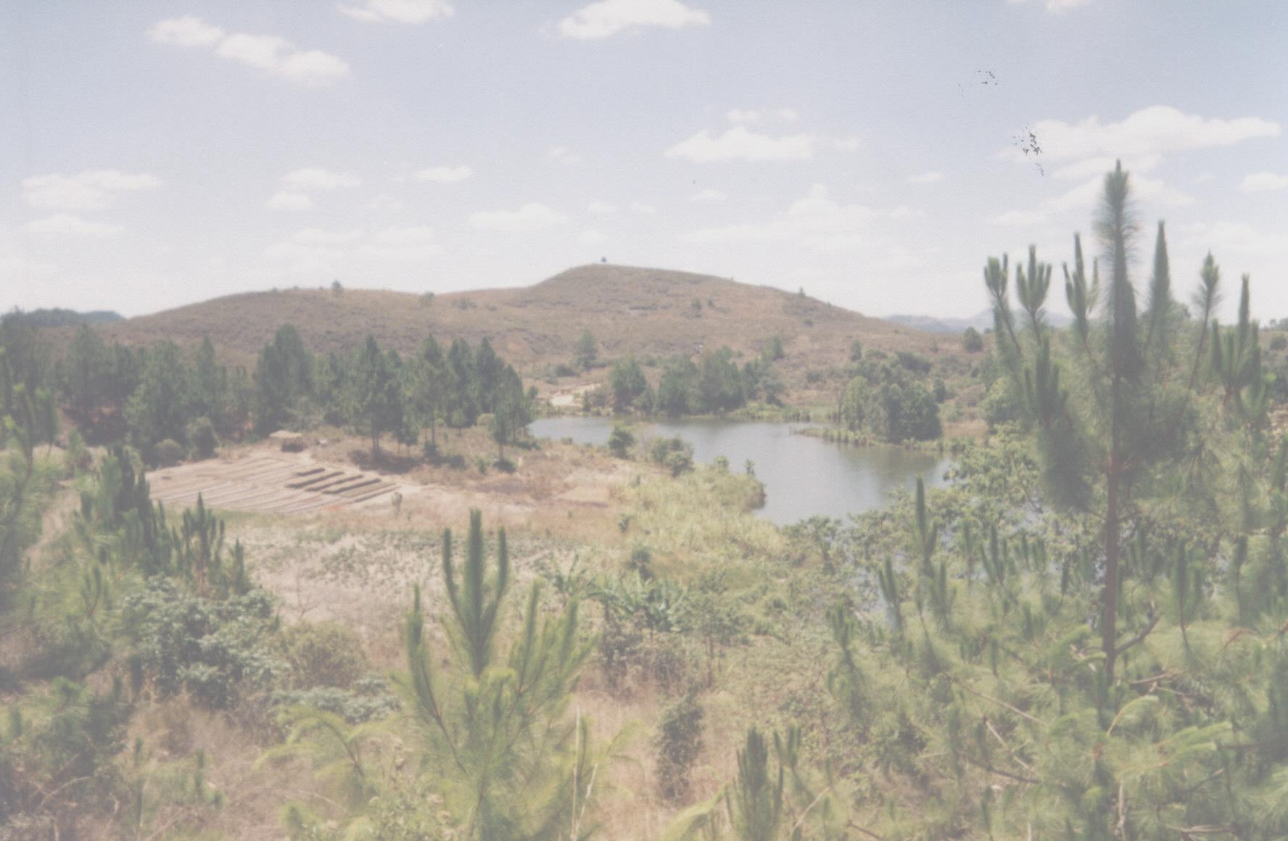
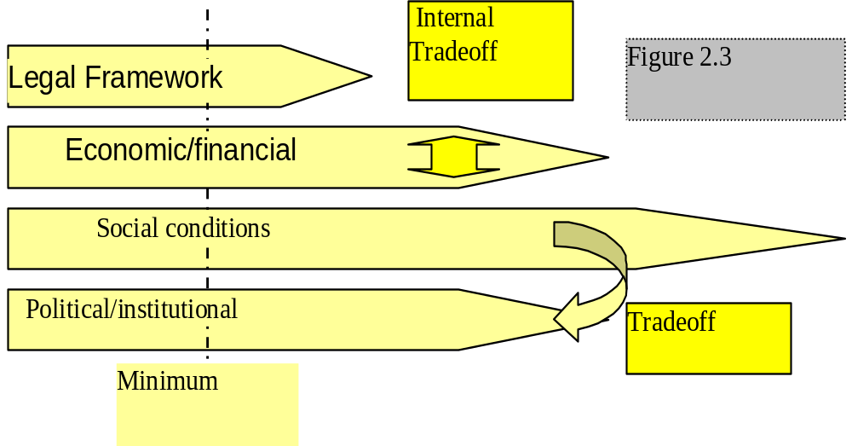
Enabling Conditions, Tradeoffs

Slide 13
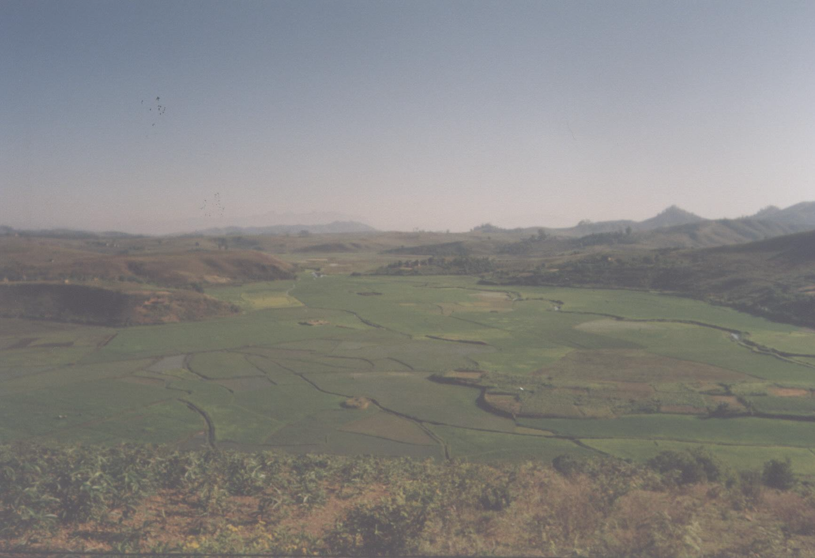
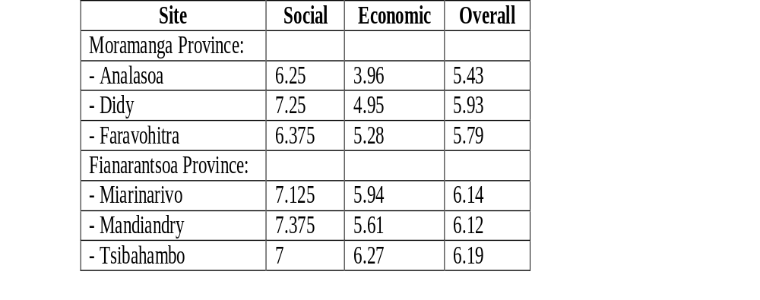
Results from Field Sites

Slide 14
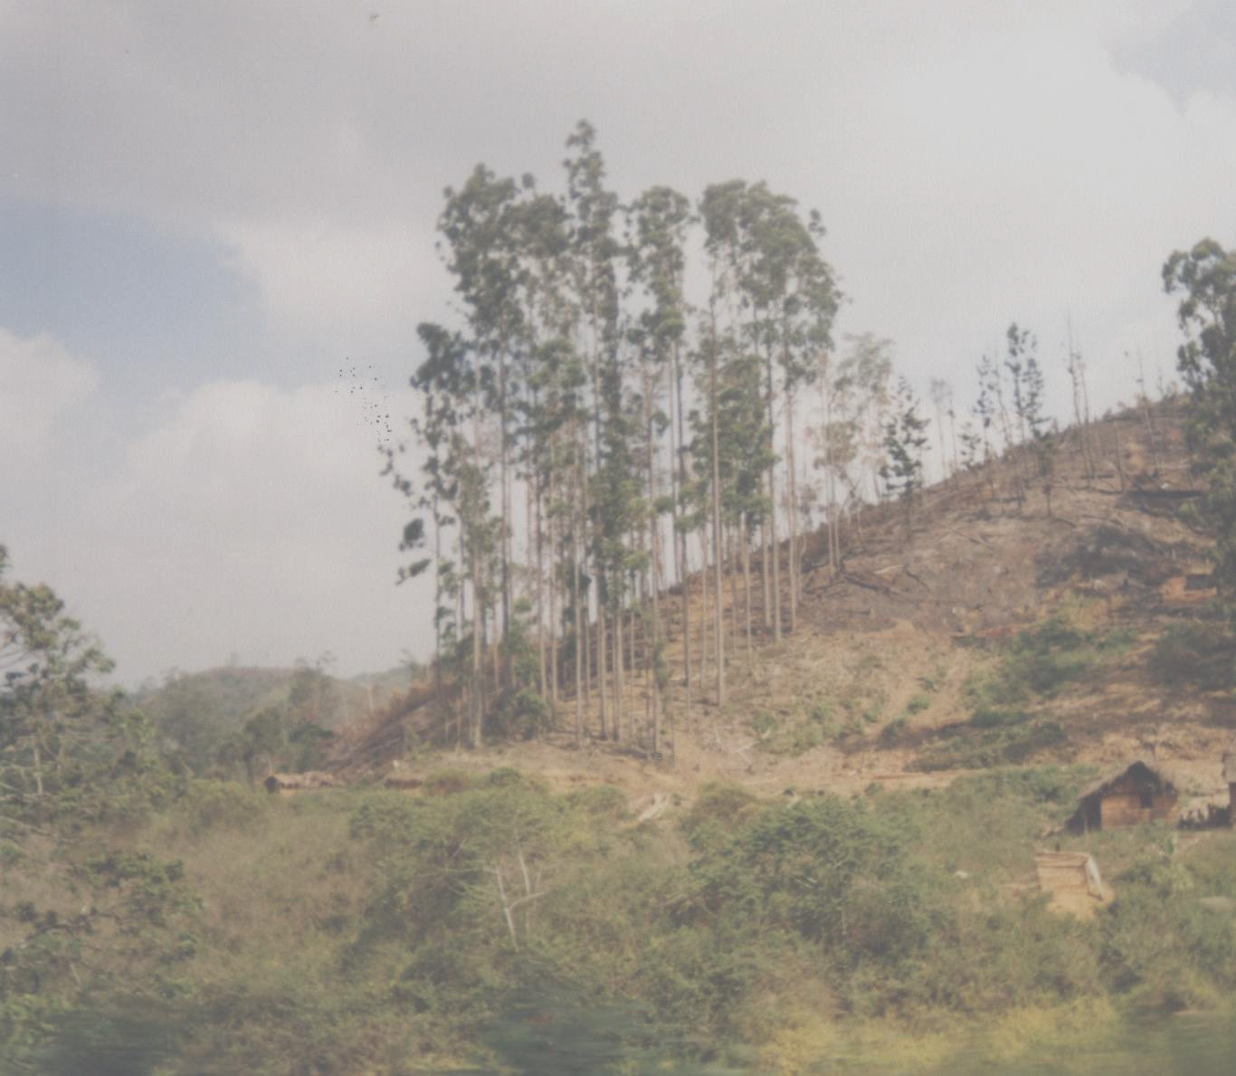
Dangers of the “Transfer Contract Race”
- Communities not fully prepared
- Obstructions and failures: discouragement
- Reverting to old practices
- Grist for the mill of detractors
- Undermining other attempts at governance in NRM

Slide 15

Strategies for ‘Scaling Up’
The choice between quantity and quality
Benefits from a critical mass of successful CBNRM cases
The ‘geyser’ effect

Slide 16
Environmental Policy Level
NRM implementation
NRM implementation
Community level - critical mass of CBNRM cases

Slide 17
Scaling Up: Elements for an Action Plan
Maintain pressure ‘from the top’ for changes in policies, their implementation, institutions
Critical mass of successful cases: being more selective
Selection criteria: mix of resource value, financial viability, potential for reaching back up into the policy process, institutions

Slide 18
Scaling Up: Elements for an Action Plan (2)
Placing CBNRM within rural development framework
Not IRDP, but enough mutually reinforcing dynamics to score high on key factors
Look for collaboration, complementarities - leverage additional resources from an attractive investment basis

Slide 19
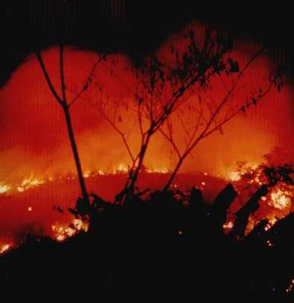
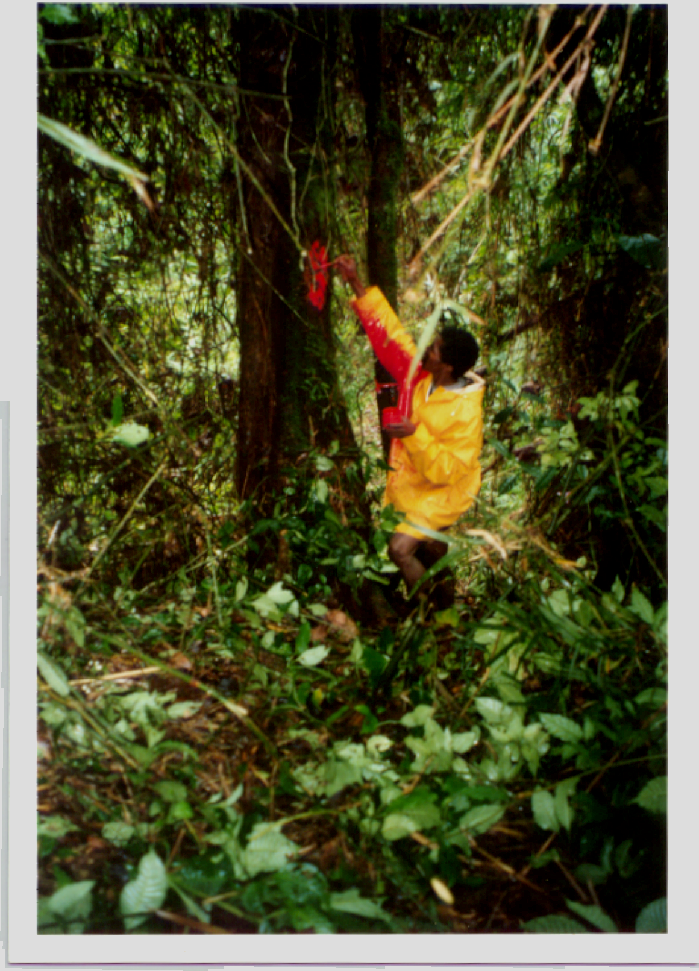
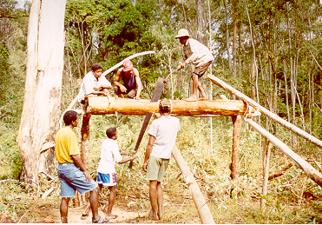

Thank you!
Comments and questions are welcome
(3 photos by WWF)

